Slide 1
Animal-Human Transmission Model of Brucellosis
EPID 634
Kyle Kumbier
Steph Mecham

Slide 2
INTRODUCTION
World Health Organization reported that livestock vaccination programs are the only truly effective strategy in preventing brucellosis transmission
Increasing knowledge of transmission patterns could increase feasibility of these programs by improving cost-effectiveness & reducing time/resources
Before this paper, brucellosis transmission models only considered singular livestock species and only studied livestock-livestock transmission
This model aims to assess both livestock-livestock and livestock-human transmission, and include multiple livestock species

Slide 3
BASIC RESEARCH QUESTION
Estimate demographic and transmission parameters between livestock and from livestock to humans
Birth rate
Mortality rate
Contact rate
Susceptibility/Immunity
Analyze cost-effectiveness & feasibility of a nationwide livestock mass-vaccination program
& its significance
Notes:
Minor objectives were: (1) to fit vaccination parameters to data on the first 3 years of the national brucellosis livestock-vaccination campaign in Mongolia and (2) to simulate the brucellosis epidemic with and without specified interventions.

Slide 4
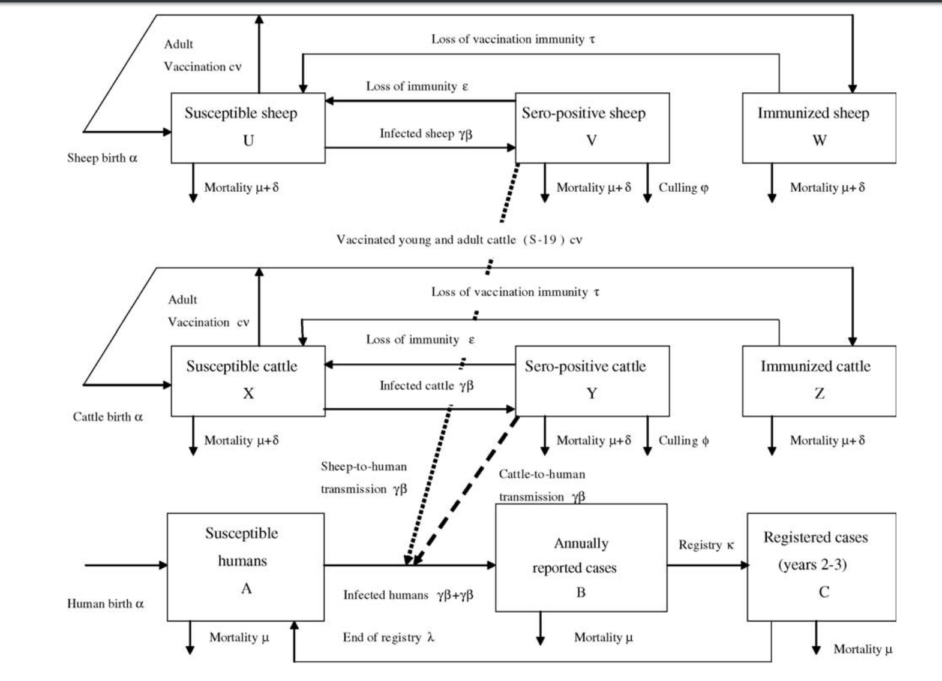
MODEL OVERVIEW
Notes:
Unable to get data on goat transmission due to lack of data

Slide 5
MODEL STRUCTURE
Deterministic & stochastic
Similar to SIRS model
Sheep/Cattle Compartments
Susceptibles
Seropositives (combines ‘Infectious’ and ‘Recovered’ due to lack of data)
Immunized
Human Compartments
Susceptibles
Reported Cases
Registered Cases (taking Mongolian health policy into account)
Takes into account culling of seropositive livestock & registration/end of registration of human cases
Accounts for transmission from sheep-to-humans and cattle-to-humans

Slide 6
SIMULATIONS
No Intervention
32% Proportion of Protection (PP) - c = 0.5; v = 0.65
52% PP - c = 0.8; v = 0.65
80% PP - c = 0.8; v = 1
PP = cv
Where v = vaccine-related reduction in transmission
And c = total vaccination coverage (simulated at 50% and 80%)
40% Proportion of seropositivity-tested and culled sheep and cattle

Slide 7
RESULTS

Slide 8
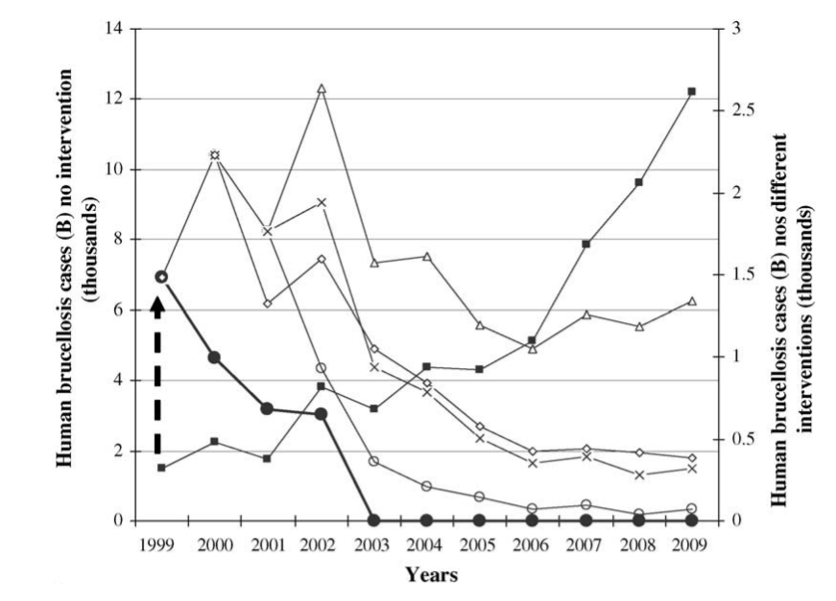
Notes:
Cases in humans

Slide 9
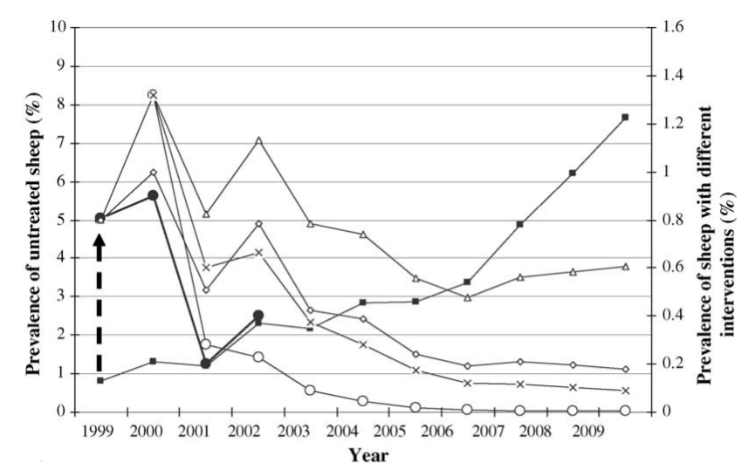
Notes:
Seropositive sheep

Slide 10
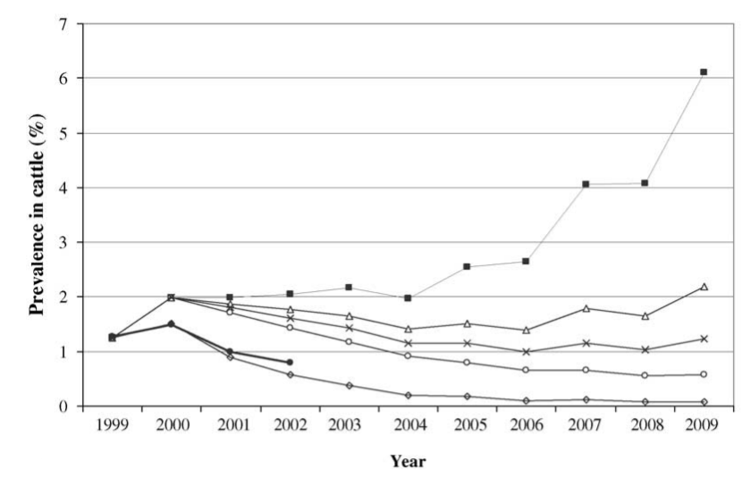
Notes:
Seropositive cattle

Slide 11
RESULTS FROM AUTHOR
Vaccine intervention was most effective when proportion of infectious sheep was 0.2-0.8 and of cattle was 0.1-0.85.
Proportion of protection (PP) necessary to disrupt transmission was 0.46 for sheep & 0.66 for cattle
Model simulations showed peak seropositivity in years 2020-2030 for sheep and humans, and 2030-2040 for cattle
Assuming stable sheep, cattle, human population size
Most human cases were infected with B. melitensis, contracted from sheep, which explains the similar peaks between sheep & humans
‘Test & cull’ strategy was comparably effective in decreasing transmission compared to mass vaccination (at a proportion of 40% tested-and-culled)
for cattle, this strategy was even more effective than vaccination
however, neither mass vaccination nor test-and-cull strategies led to brucellosis elimination in cattle over a 10-year period

Slide 12
Appropriate for the author’s research question?
Yes -- research question was to:
get a comprehensive picture of demographic and transmission dynamics among cattle, sheep, and human populations
simulate effectiveness of vaccine interventions and test-and-cull interventions
This model was successful in identifying necessary parameters to achieve peak transmission disruption → potential policy directions
Mass-vaccination more effective in preventing transmission from sheep
Test-and-cull more effective in preventing transmission from cattle

Slide 13
RESULTS FROM OUR MODEL

Slide 14
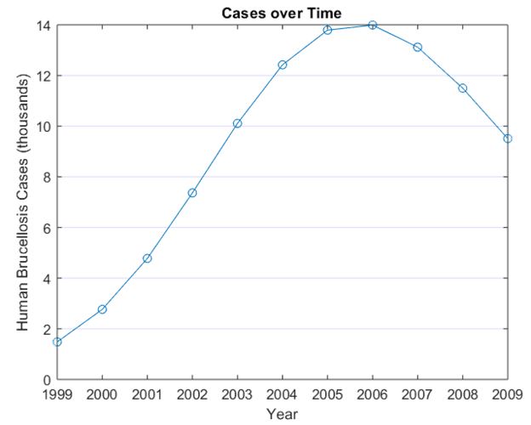

Slide 15
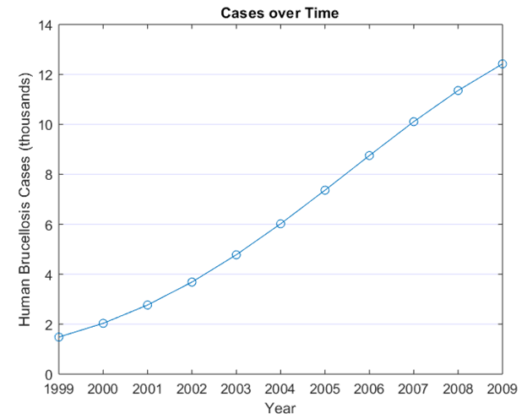

Slide 16
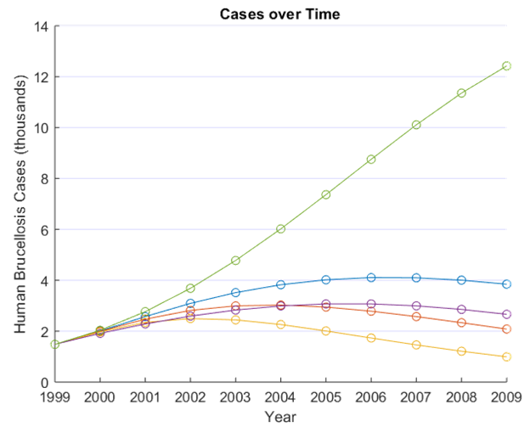

Slide 17
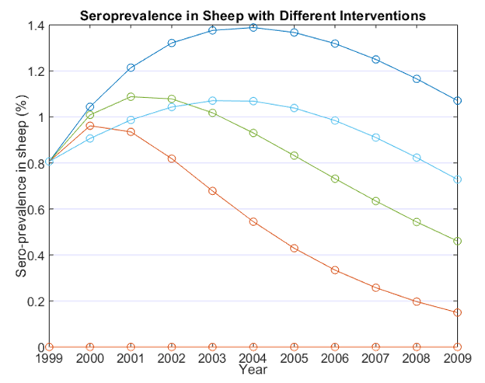

Slide 18
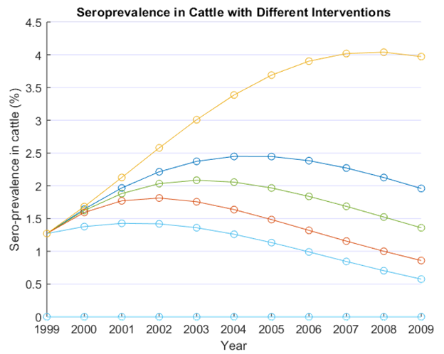

Slide 19
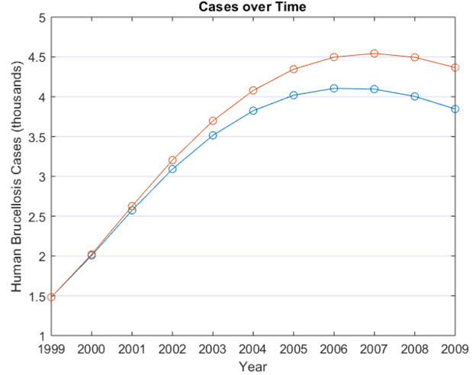
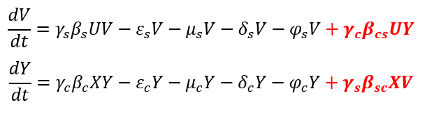
OUR MODIFIED MODEL:
Taking into account transmission between sheep and cattle
Added two new transmission terms
sheep → cattle transmission
cattle → sheep transmission
contact rates arbitrarily chosen

Slide 20
OUR MODIFIED MODEL
PARAMETERS
𝜏_{rev} = 0.25 [loss of vaccination immunity in sheep]
𝜏_{rev} = 0.142 [loss of vaccination immunity in cattle]
ε_{s} = 0 [sheep immunity-loss constant]
ε_{c} = 0 [cattle immunity-loss constant]
α_{s} = 0.811 [birth rate of sheep]
α_{c} = 0.273 [birth rate of cattle]
α_{h} = 0.018 [birth rate of humans]
V_{rev1} = 0.65/1 [vaccine efficacy of Rev1]
V_{s19}= 0.65/1 [vaccine efficacy of S19]
μ_{s} = 0.78 [mortality rate of sheep];
μ_{c} = 0.226 [mortality rate of cattle];
μ_{h} = 0.003 [mortality rate of humans];
𝜂 = 0.325 [prevalence-dependent decrease of sheep/cattle birth]
ẟ_{s} = 0.106 [excess sheep mortality due to snowstorm]
ẟ_{c} = 0.221 [excess cattle mortality due to snowstorm]
𝛾_{s} = 0.66 [proportion of infectious seropositive sheep]
𝛾_{c} = 0.8 [proportion of infectious seropositive cattle]
β_{s} = 1.56e-7 [sheep contact rate]
β_{sh} = 1.127e-8 [sheep-human contact rate]
β_{c} = 3.49e-7 [cattle contact rate]
β_{ch} = 2.11e-9 [cattle-human contact rate]
c_{ys} = 0/0.5/0.8 [young sheep vaccination coverage]
c_{yc} = 0/0.5/0.8 [young cattle vaccination coverage]
c_{as} = 0/0.5/0.8 [adult sheep vaccination coverage
c_{ac} = 0/0.5/0.8 [adult cattle vaccination coverage]
φ_{s} = 0/0.4 [proportion of sheep test-and-culled]
φ_{c} = 0/0.4 [proportion of cattle test-and-culled]
λ= 0.5 [end of registry constant];
k = 1 [registry];
INITIAL CONDITIONS
U₀ = 15069770 [# susceptible sheep];
V_{o} = 121530 [# seropositive sheep];
W_{o} = 0 [# immune sheep];
X_{o} = 3776780 [# susceptible cattle];
Y_{o} = 48018 [# seropositive cattle];
Z_{o} = 0 [# immune cattle];
A_{o} = 2446400 [# susceptible humans];
B_{o} = 1482 [# reported cases];
C_{o} = 0 [# registered cases];

Slide 21
LIMITATIONS
The model does not take into account geographical differences or age dependency of disease prevalence
Not enough data to study goats, yaks, or camels
Relatively large time-steps may reduce accuracy
Number of vaccinated livestock may be overestimated compared to reality
Model projections assume that livestock populations will remain relatively stable

Slide 22
ISSUES WE ENCOUNTERED
Setting the initial conditions for susceptible sheep & cattle
Replicating the original model was more successful when simulated for shorter time-periods (i.e. replication became less accurate the further out the model ran)
Some small errors in the paper

Slide 23
Conclusion
& BROADER IMPACTS

Slide 24
Our model shows that mass vaccination of livestock indeed expedites the halt of brucellosis transmission, similar to the authors’ findings
Public health relevance: this model helps to identify the smallest proportion of sheep/cattle necessary to immunize in order to halt transmission to humans → saves time and resources
Compensating livestock owners to immunize their animals, or to make up the losses for culled seropositive animals, may be most effective way to ensure compliance

Slide 25
THANK YOU
Any questions?

